Slide 1
AP Gov
China Notes
China from the Inside
Village Elections
Judicial Reform

Slide 2
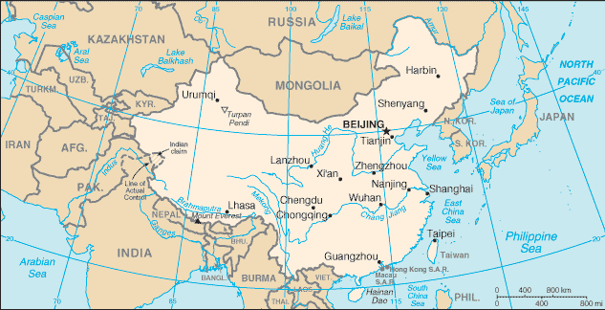
People’s Republic of China (1949 ) Population Size: 1.3 billion 90% Han (Uyghur & Tibet are minority groups) Unitary System of Government; Communist one party government Hong Kong and Maco (administrative Units); Taiwan independent
What is useful about China as a case study?

Slide 3
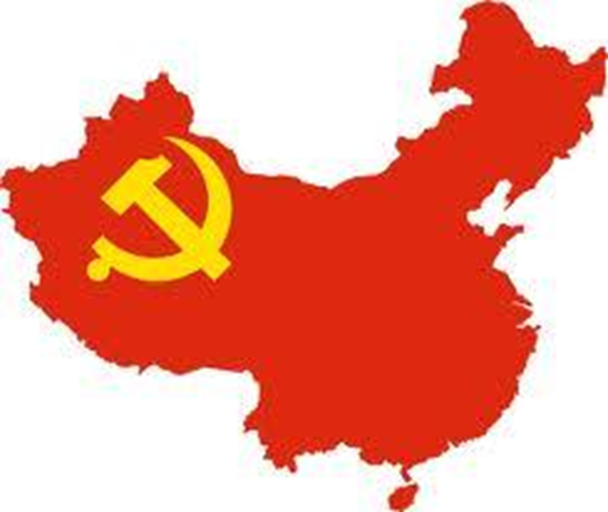
Brief History:
Mao Zedong won the Civil War with the Kuomintang & created the People’s Republic of China (1949)

Slide 4
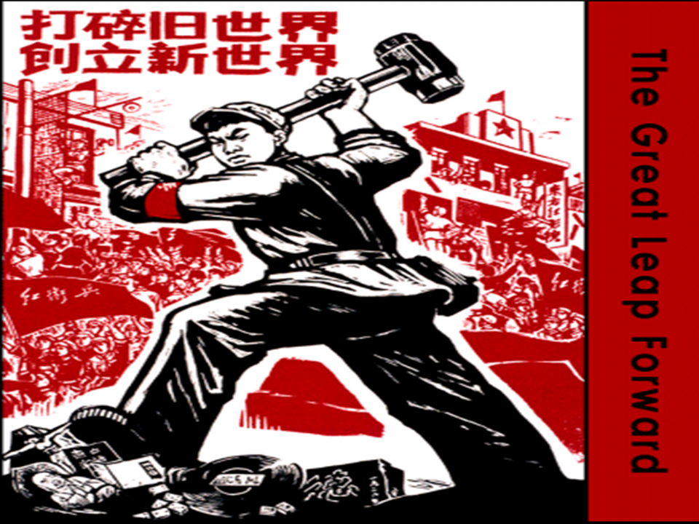
The Great Leap Forward – 1958
Mao’s goal to greatly increase agricultural and industrial production

Slide 5
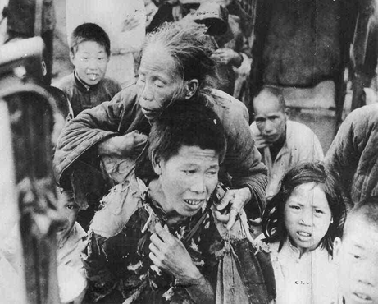
The Great Leap modernized the country, but ultimately failed to improve living conditions because:
China changed too quickly; No expert advice was used; Natural disasters/peasant discontent led to famine
•30 million died

Slide 6
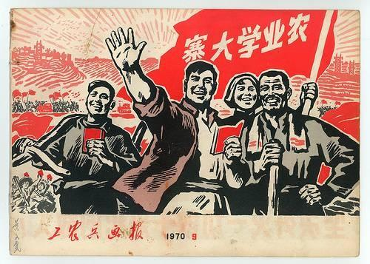
The Cultural Revolution
a.Abolish Old Customs, Old Culture, Old Habits, and Old Ideas
b.Get rid of intellectuals and Mao’s political enemies

Slide 7
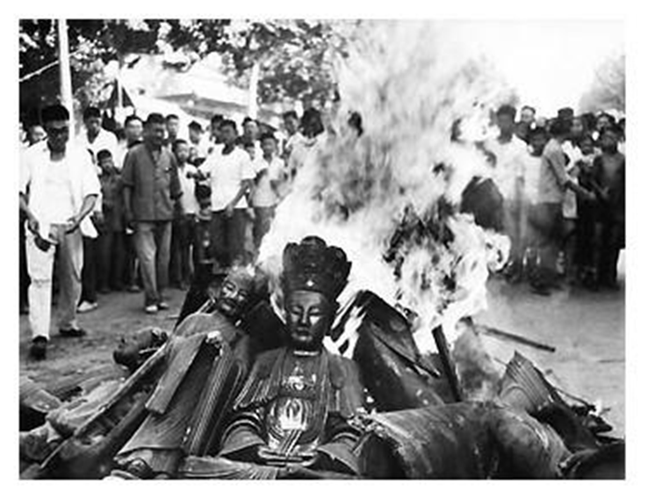
Destruction of the Old Ways

Slide 8
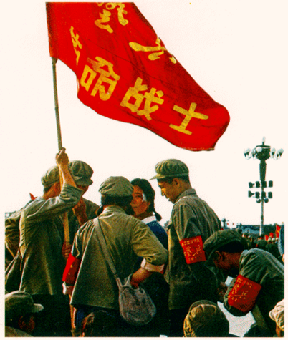
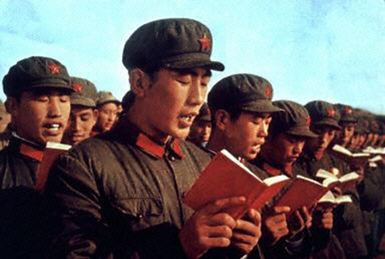
Red Guards with “Little Red Book”
“Top Down” political participation

Slide 9
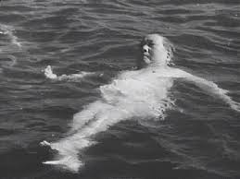
Propaganda

Slide 10
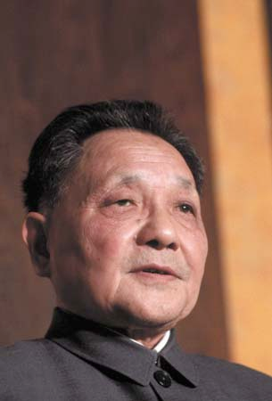
Deng Xiaoping (1978-1992)
After Mao Zedong’s death, China is ruled by the “Gang of Four” for a short period of time.
Deng Xiaoping replaces them as CCP leader, and dramatic changes occur in China.

Slide 11
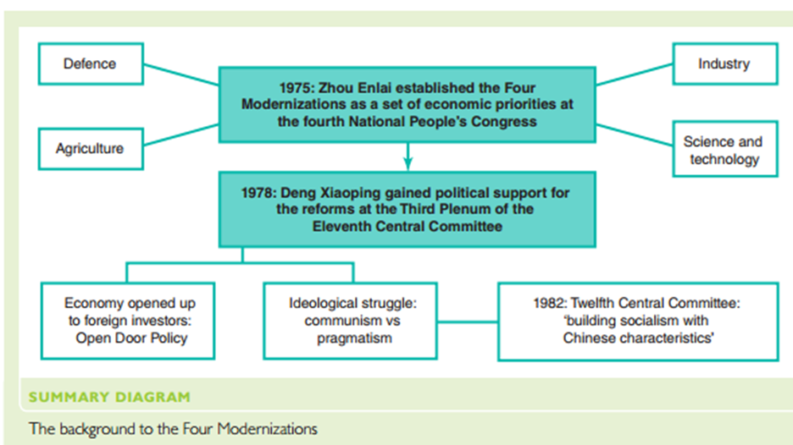
Democracy = 5th Modernization

Slide 12
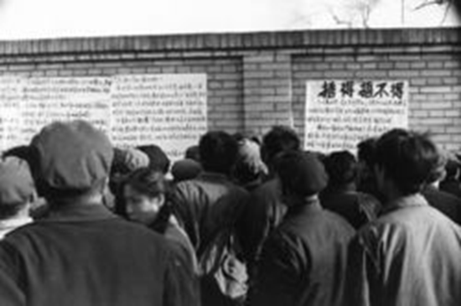
Democracy Wall 1978-79
This did not go well for citizens.

Slide 13
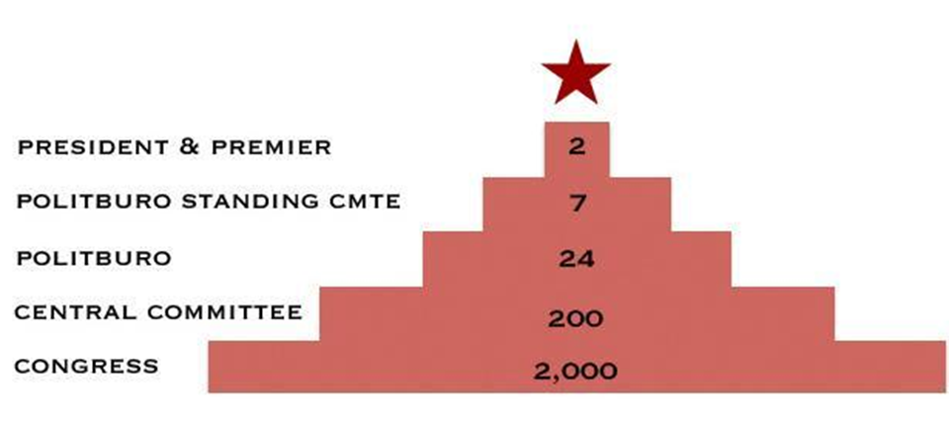
China – Branches of Government
One Party Rule

Slide 14
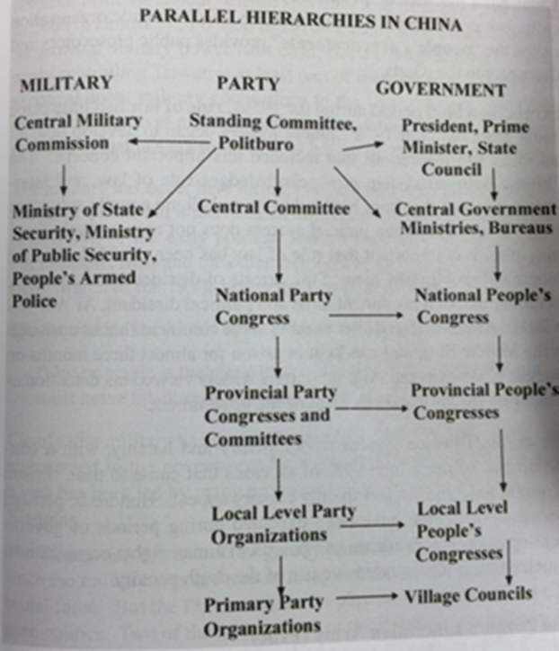

Slide 15
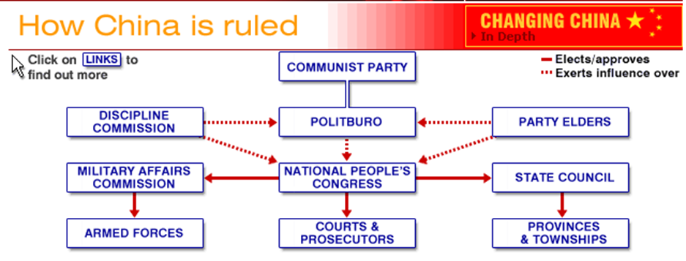

Slide 16
China - Topics of Focus
1. Political Change
-Little Change in CCP structure (- CCP recruits capitalists)
-Occasional Open Politburo Debate Debate
-Anti corruption mechanisms
-Little Change in judicial structure
-Village Elections
2. Economic Change
-Slow (especially compared to Russia)
-Deng Xiaoping initiates privatization/market

Slide 17
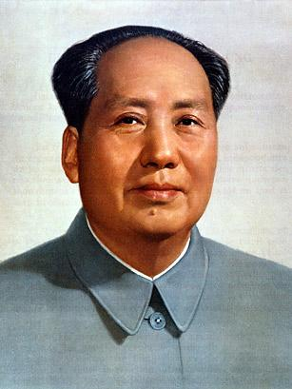
Modern China - Political Change
Cultural Revolution Legacy
-Judicial System
(A) code law & lack of independent judiciary
(B) prosecutors win cases swiftly/harsh penalties
-death penalty/torture for political crimes
-re-education through labor
-high # of political prisoners/dissidents
-Judicial Reform
Legal training for lawyers and judges today(post college)
Private Law Firms emerge in the 1980’s (protect property)
Internal system developed to penalize corrupt CCP

Slide 18
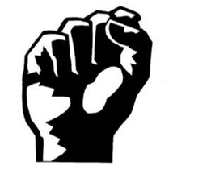
Deng’s Iron Fist
During Deng's economic reforms he kept an iron fist ready to crush any threats to the nation's Communist dictatorship.
In Deng's final five years, virtually all of China's dissidents were imprisoned or exiled abroad.

Slide 19
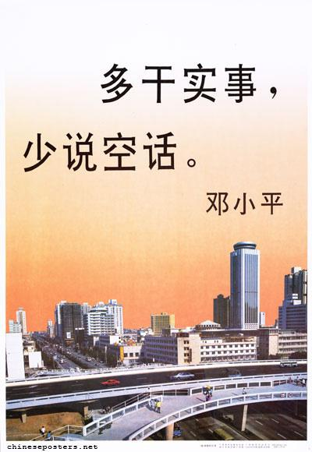
Modern China – One Party Rule
State Owned Press/TV/Entertainment industry
-China News Daily (English version available on-line)
-Foreign /private journalism with approval -
Dahzhibao – posters still common.
Lack of Transparency (SARS)
Censorship of Internet
Social Media banned (FB/Twitter)
“Jasmine” censored
China employs 20,000 internet censors
Crackdowns on Protests/Dissent
Tiannanmen Square
Falun Gong
Labor Protests – hundreds of thousands

Slide 20
China – results of economic change
Market forces = economic boom & unequal wealth
Privatization = no guaranteed “iron rice bowl”
Fewer working in danwei and unraveling of hukou; many migrant workers flock to cities
“Guanxi” capitalism
Environmental consequences

Slide 21
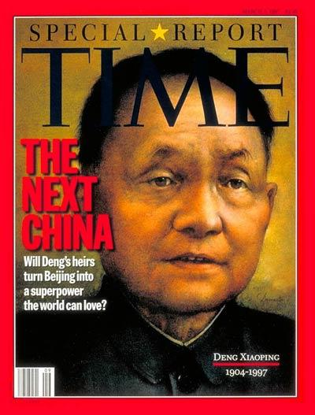
Economic Reforms under Deng Xiaoping (1980s)
Special Economic Zones (SEZs)
2) Privatization (private companies compete against State Owned Enterprises (SOEs)
3) Entrepreneurs allowed to form their own businesses
4) Private property rights codified in the Constitution
5) Agricultural Reform
Same man who sent tanks out to squash Tiananmen Sq. protesters!!

Slide 22
Identify and describe the Political and Economic changes that have occurred in China since Mao’s death.
Describe the changes that have come in China’s Judiciary
Identify Iron Rice Bowl, Danwei, Hukou and Guanxi Capitalism.
Work in Study guide for rest of period.
Political and Economic Change in China.

